Slide 1

Tidy Data
Carol J Wilusz
Colorado State University

Slide 2
What platforms are you currently using for collecting, storing and analyzing your data?
Excel
Graphpad Prism
R
MatLab
Python

Slide 3
The benefits of Tidy Data
Easier (for you, collaborators, computer etc) to find and understand information
Easier to manipulate and visualize the data computationally

Slide 4
Some bad habits - why are these bad?
Using color to convey meaning
Merging multiple variables into one column
Not keeping track of how you analyzed/changed your data
Analyzing on the same spreadsheet as the raw data
Putting units in the same cell as the values
Inconsistent formats
Not defining what empty data means

Slide 5
Some bad habits
Using color to convey meaning (not machine readable)
Merging multiple variables into one column (difficult to visualize/plot)
Not keeping track of how you analyzed/changed your data (not reproducible)
Analyzing on the same spreadsheet as the raw data (can easily change the raw data)
Putting units in the same cell as the values (changes numbers into text)
Inconsistent formats (dates, units, capitalization, acronyms - makes analysis hard)
Not defining what empty data means (not recorded, zero, accidentally deleted)

Slide 6
Example of Untidy Data
README NOTES:
This experiment was performed to measure cytokine levels and weight of mice that were infected with a parasite over the course of one year. 8 mice were infected with the parasite, 8 were used as uninfected controls.
* Weight was recorded daily
* Cytokine levels were recorded monthly (4 x proinflammatory, 2 x anti-inflammatory)
* There are 24 files, 12 for weight, 12 for cytokines
Also there is another table about the mice in MouseInventory.xls

Slide 7




How might you want to present the data from this experiment?
uninfected
infected
 | Jan | Feb | Mar | Apr | May | Jun | Jul | Aug | Sep | Oct | Nov | Dec
Weight | 8 x 2 x 31 | 8 x 2 x 28 | 8 x 2 x 30 | 8 x 2 x 30 | 8 x 2 x 31 | 8 x 2 x 30 | 8 x 2 x 31 | 8 x 2 x 31 | 8 x 2 x 30 | 8 x 2 x 31 | 8 x 2 x 30 | 8 x 2 x 31
Cytokines | 8 x 2 x 6 | 8 x 2 x 6 | 8 x 2 x 6 | 8 x 2 x 6 | 8 x 2 x 6 | 8 x 2 x 6 | 8 x 2 x 6 | 8 x 2 x 6 | 8 x 2 x 6 | 8 x 2 x 6 | 8 x 2 x 6 | 8 x 2 x 6
5840 weights
1152 concentrations
# of measurements

Slide 8
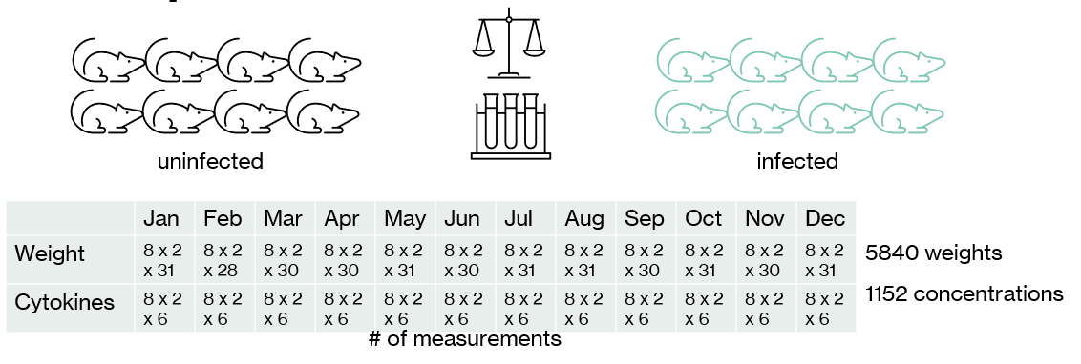
How might you want to present the data from this experiment?
Infected
TNF alpha
Uninfected
There are many ways to visualize data from this experiment!
Most of them will require looking at how values change over time
Calculating mean values for different treatments might be useful
Time
uninfected
U1
Mean weight
Weight
U2
infected
I1
I2
Time (month)
Time (days)

Slide 9
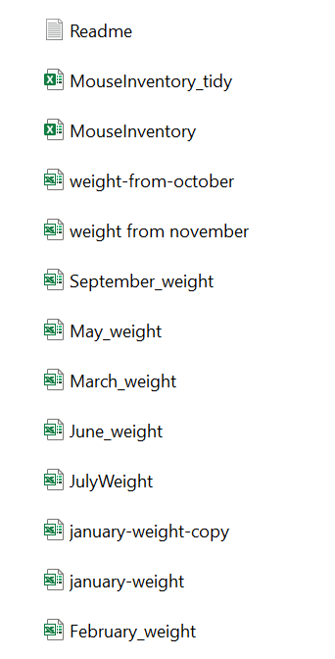
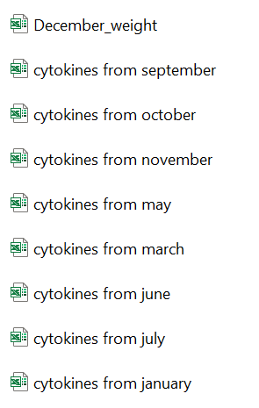
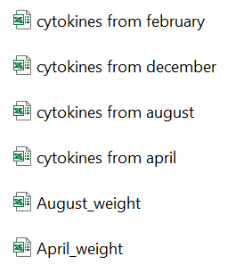
Data Folder
What are some problems here?

Slide 10
Data Folder
Inconsistency with naming
No easy way to sort files that are related to each other (date conventions ignored)
Filenames contain useless info (“from”)
Filenames are not computer readable (spaces in them)
Not clear what month the experiment started
28 different files for 1 experiment
No easy way to generate a chart that tracks changes over time!
Duplicate files

Slide 11
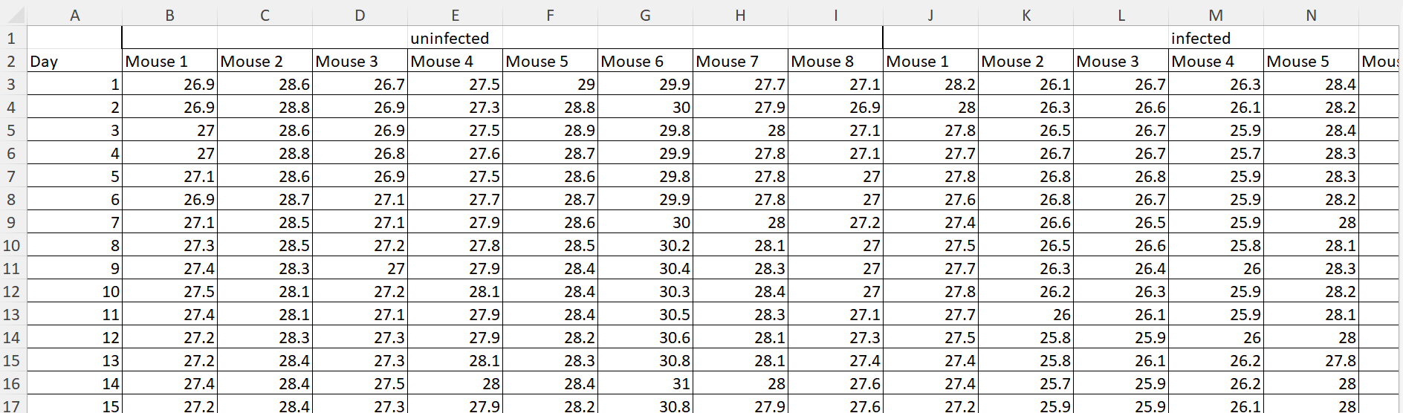
Weight Data
Good things about this spreadsheet –
Only 1 tab – easy to export and import
Filename is machine readable and tells what contents are
A person who read the readme file can interpret the data
September_weight.xlsx

Slide 12
Weight Data
What is not so great about this spreadsheet?
Empty cells
September_weight.xlsx
These two columns are not actually distinguishable because the uninfected and infected label is “assumed” - computers can’t assume!
Column headers don't say what they contain!
Date is not actually a date
Makes it challenging to merge so all data for the year are in one file

Slide 13
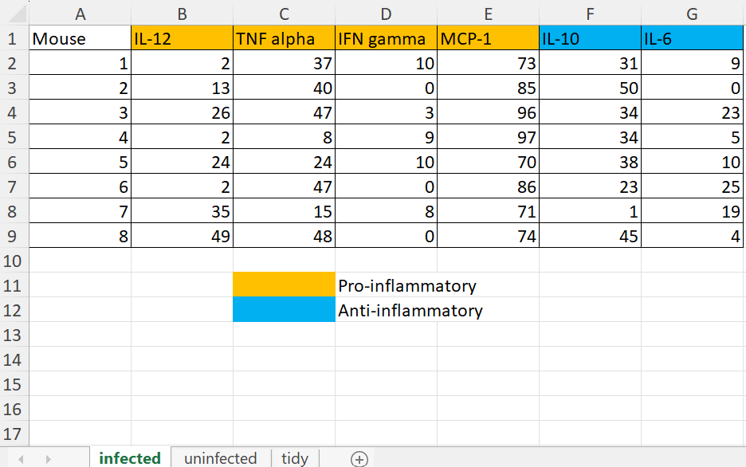
Cytokine Data
Good things about this spreadsheet
A person who read the readme file can interpret the data
Cytokines from january.xls

Slide 14
Cytokine Data
What are some problems here??
Cytokines from january.xls

Slide 15
Cytokine Data
What are some problems here??
Cytokines from january.xls
Not Machine Readable:
Information on two separate tabs
Information conveyed through color coding
No date in the data (only in file name)
No distinction between the data on the two tabs (except on the tab label)
No easy way to merge files so that data can be compared over the whole year

Slide 16

While the dataset is interpretable it is not easy to use (which means it is not tidy!)

Slide 17
Three Principles of Tidy Data
Each Variable Forms a Column
Each Observation Forms a Row
Each Cell is a Single Measurement

Slide 18
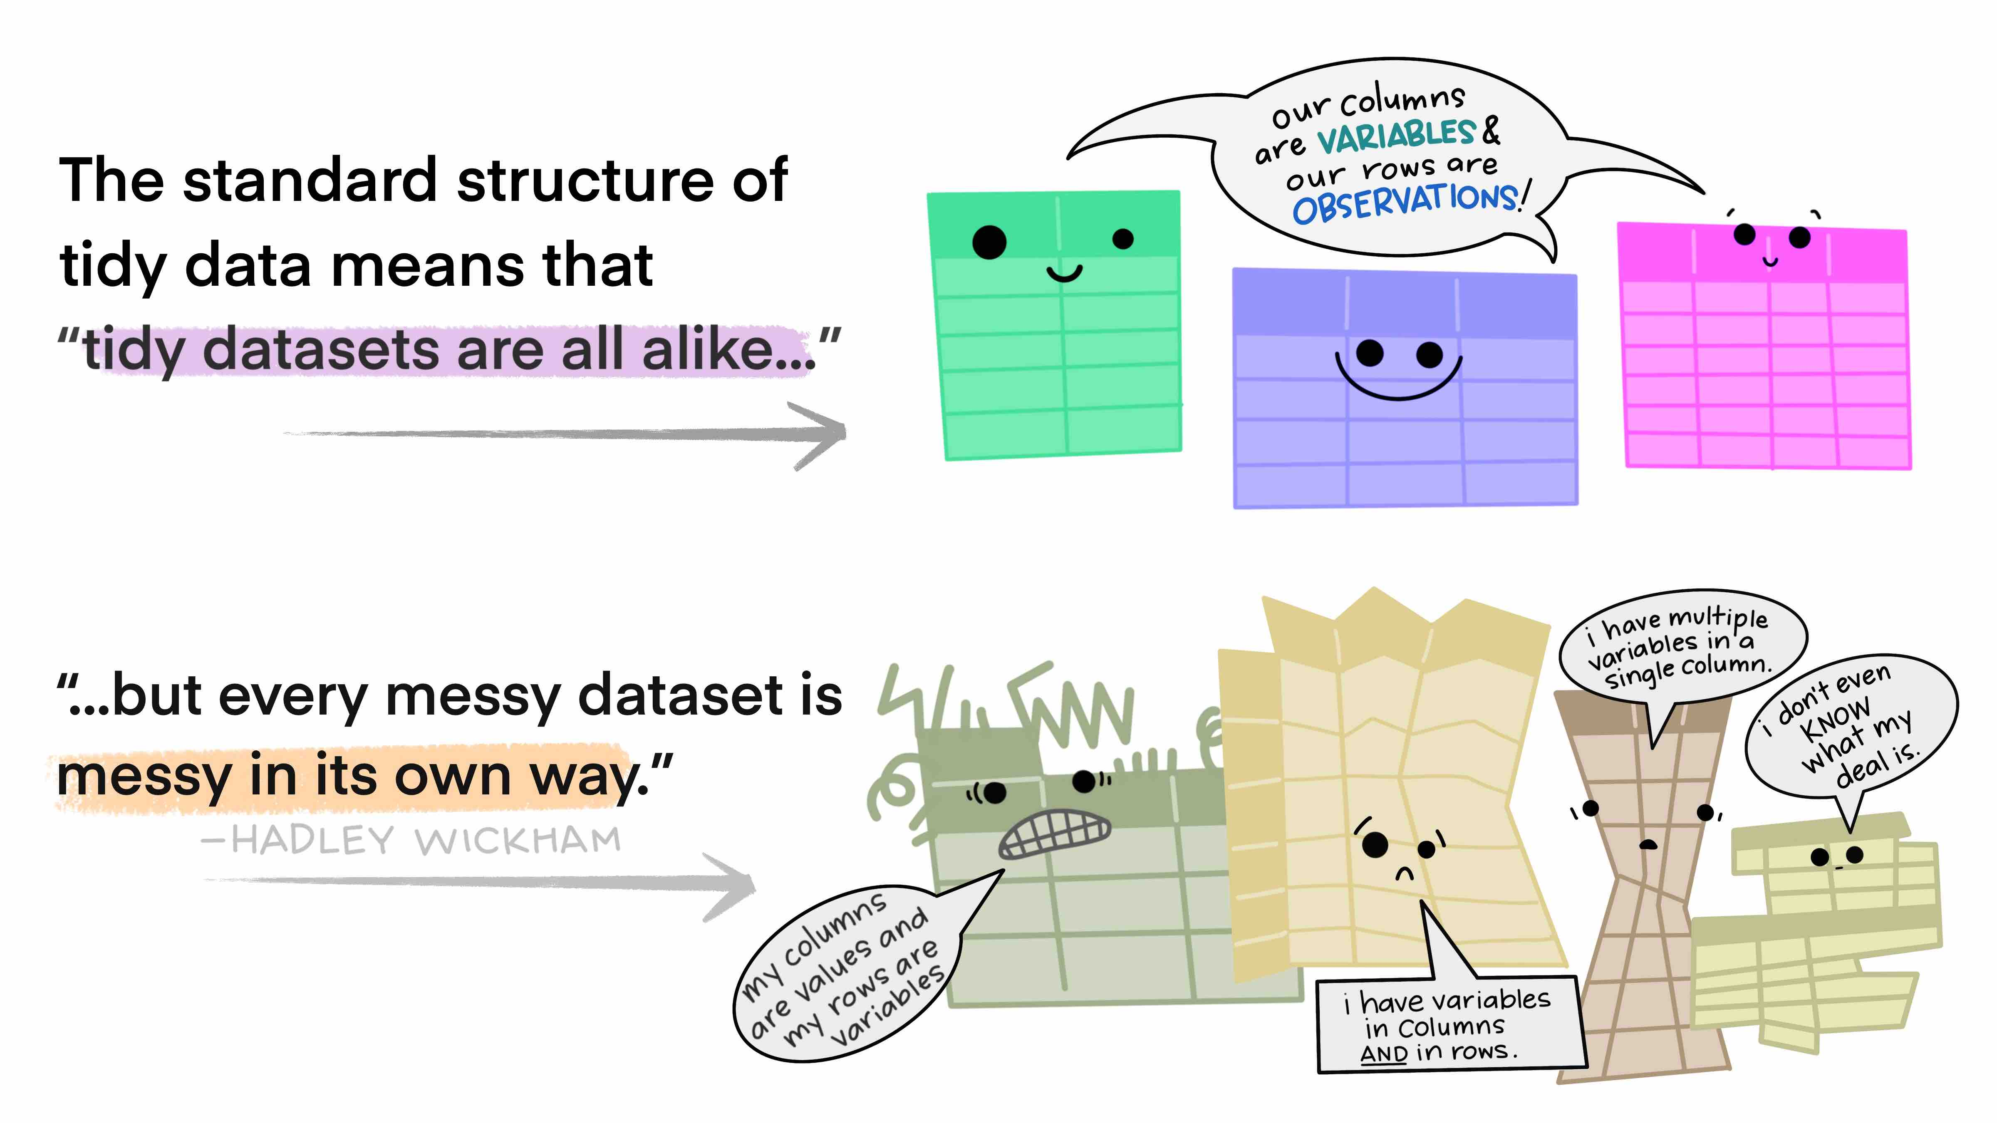
Common

Slide 19
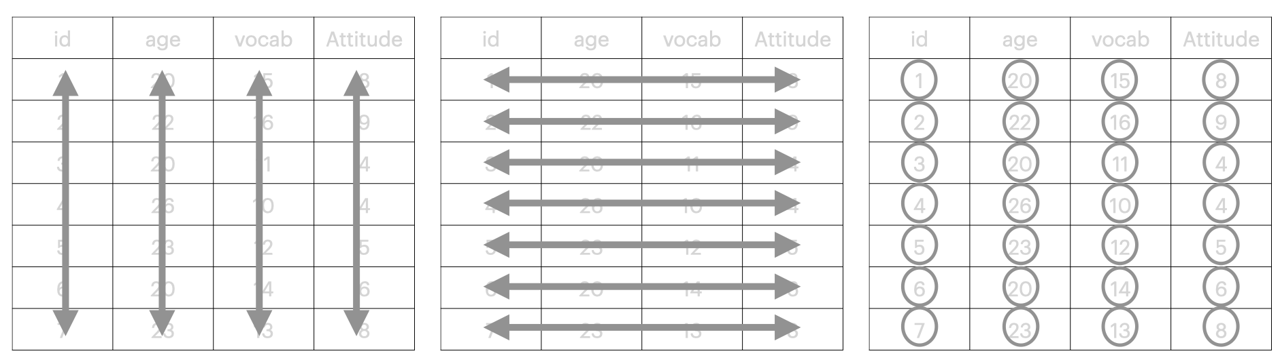
Variables
Observations
Values
Gene
Weight
Date
Ct value
Fluorescence
Color
A260
Concentration
Sex
Time
ID#
Species
Values belong to a variable and an observation

Slide 20
Fixed versus Measured Variables
Fixed variables can be measured without error and are determined by the experiment design
Measured variables are collected/recorded during the experiment
What are some examples of these two different types of Variable?

Slide 21
Fixed versus Measured Variables
Fixed variables can be measured without error and are determined by the experiment design
Date
Sex
Gene_name
Species
Measured variables are collected/recorded during the experiment
Weight
Ct value
Band_intensity
Relative_Fluorescence_Units

Slide 22
Weight Data
What are the variables in this experiment?
September_weight.xls

Slide 23
Weight Data
What are the variables in this experiment?
Date
Weight
MouseID
Treatment
September_weight.xlsx
Date
All these columns have the same variable – weight!

Slide 24
Which variables are fixed (by the design) and which are measured (during the experiment)?
Date
Weight
MouseID
Treatment

Slide 25
Which variables are fixed (by the design) and which are measured (during the experiment)?
Date
Weight
MouseID
Treatment

Slide 26
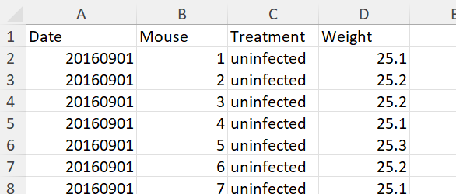
Tidy Weight Data
Each row is now unique and can be sorted, filtered, visualized by date, mouse, treatment etc
The table is MACHINE-READABLE
fixed
fixed
fixed
measured
variables
observation
Easy to merge with another dataset – next month (more observations), another variable (new column)
The column header tells what the data is!

Slide 27
Tidy Weight Data
What are the negatives to this approach?
variables
observation
For a year of data this table has >5000 rows, one for every observation

Slide 28
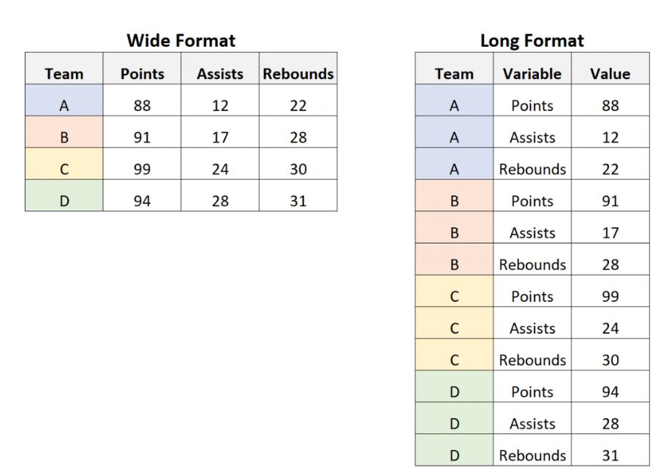
Long versus Wide Data
Values in first column do not repeat
Often easier for humans to read
Can be generated from long format in Excel using PivotTables
Easy to create a new column and calculate mean etc.
Column name is not always informative
Values in first column repeat
Necessary for machines to read (e.g. R)
Helpful if you want to look at data in different ways
Easier to add additional variables or merge tables

Slide 29
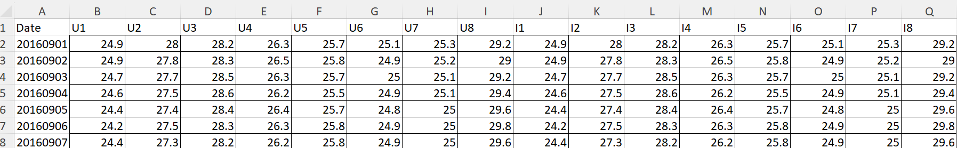
Wide Weight Table
Each row is a unique date
Each column is a unique mouse
Two variables merged into column heading (infection status and mouse #)
Table for a whole year still has 365 rows and 17 columns!
You could quite easily add data for another mouse, or for another date
You could not easily add another variable such as temperature or gender – would need another table

Slide 30
Cytokine Data
What are the variables in this experiment?
Cytokines from january.xls

Slide 31
Cytokine Data
What are the variables in this experiment?
Cytokines from january.xls
Date
Mouse
Treatment
Cytokine_name
Cytokine_type
Cytokine_concentration

Slide 32
Cytokine Data
Which variables are fixed vs measured?
Cytokines from january.xls
Date
Mouse
Treatment
Cytokine_name
Cytokine_type
Cytokine_concentration

Slide 33
Cytokine Data
Which variables are fixed vs measured?
Cytokines from january.xls
Date
Mouse
Treatment
Cytokine_name
Cytokine_type
Cytokine_concentration

Slide 34
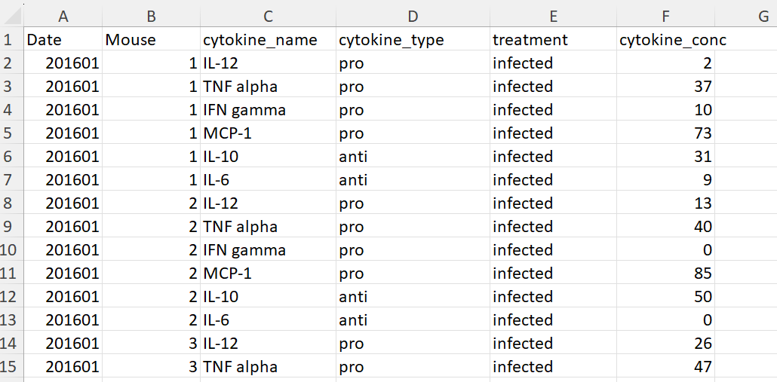
Tidy Cytokine Data
Measured variable goes at the end
variables
observation

Slide 35
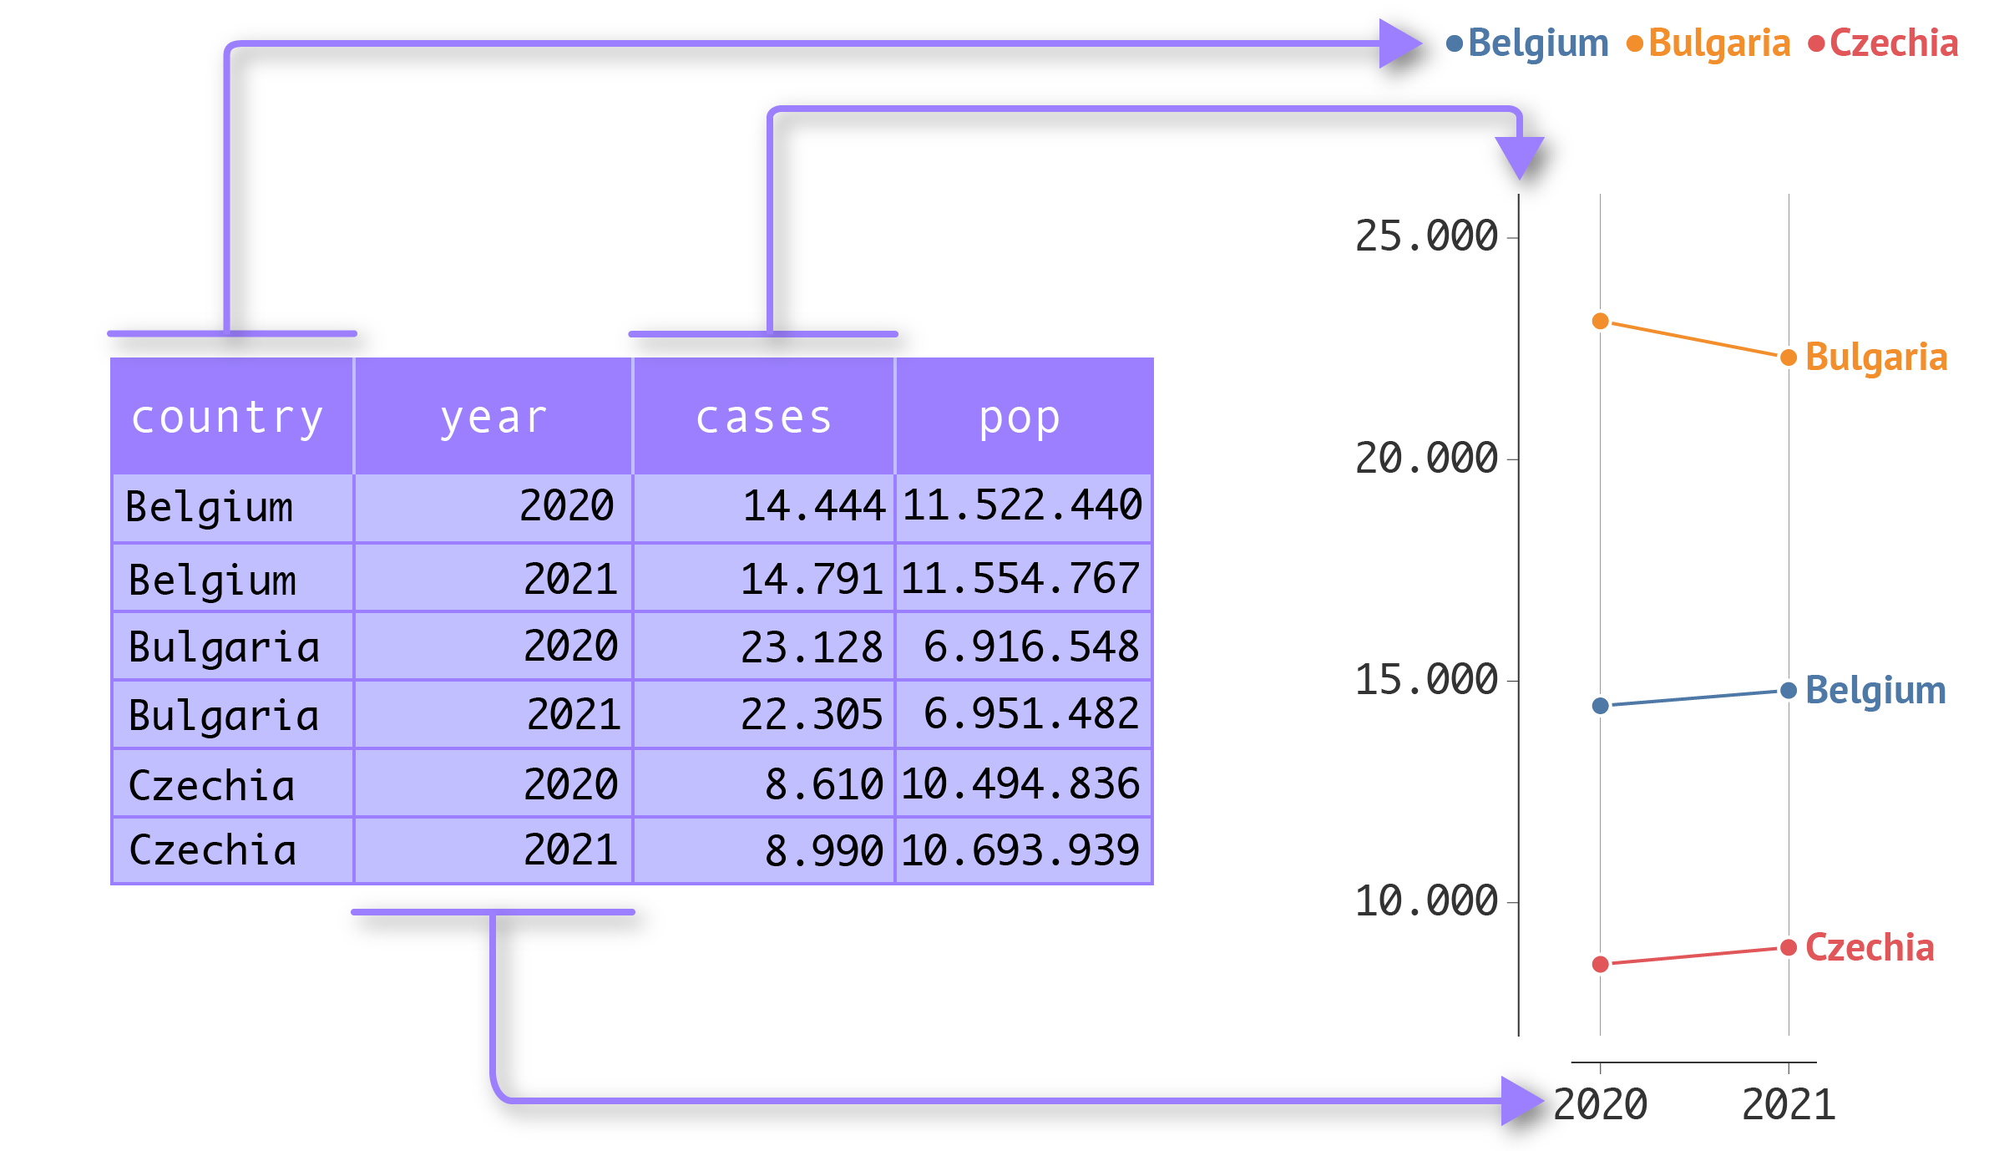
Value of tidy data is for visualization and manipulation of data in R, Tableau and similar platforms
5
10
20 million

Slide 36
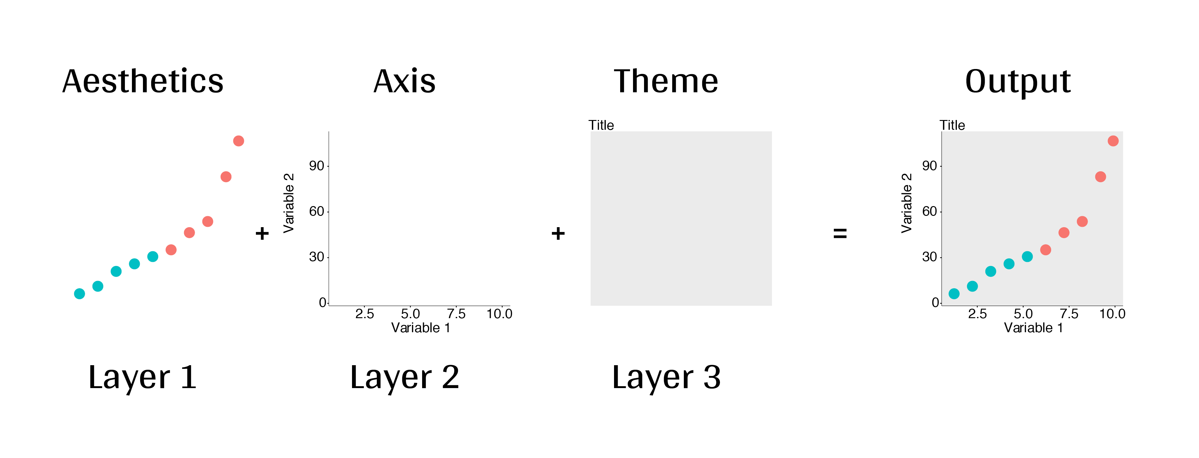
Grammar of Graphics
a framework for data visualization that dissects each component of a graph to create distinct layers
Easily assign variables to different properties (shape, size, color of datapoints)
[Variable 4 (shape)]
[Variable 5 (size)]
Variable 3 (color)
https://r.qcbs.ca/workshop03/book-en/grammar-of-graphics-gg-basics.html
Used by ggplot2 in R

Slide 37
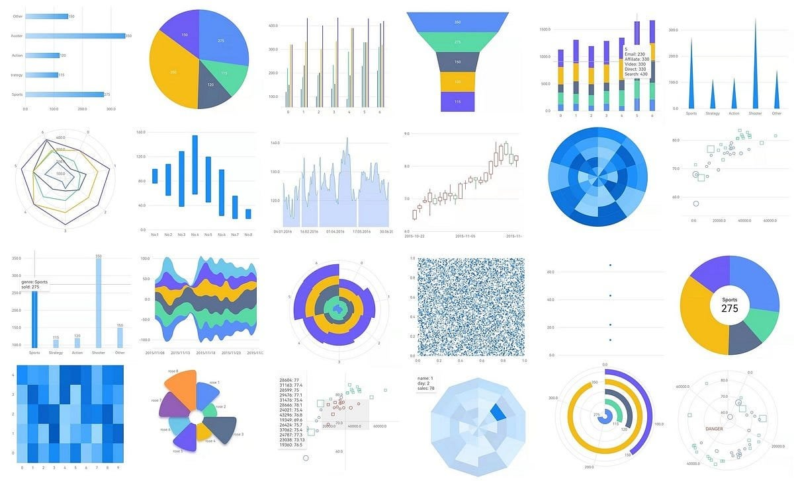

Slide 38
How to tidy up your data
Manually in Excel
Rename columns
Find/Replace
Enter NA in empty cells
Unmerge cells, or make sure labels are complete
Split cells that have more than one variable in them
Pivot wider or longer (PivotTables)
Use R Tidyverse (does the same as the above using code)
Use ChatGPT – but supervise it and give it clear instructions

Slide 39
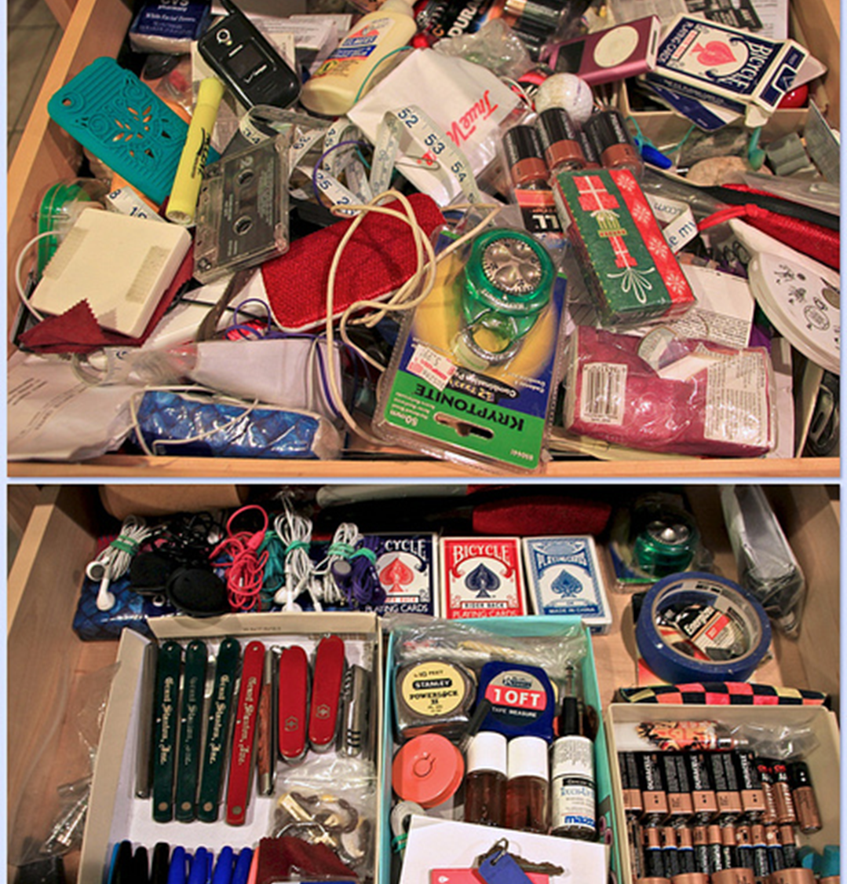
Take Home
Using a standardized format (Tidy) makes your data more accessible and easier to analyze
Tidy data principles:
Each column is a variable
Each row is an observation
Each cell is a single value
When your data is tidy, visualization is easy
Using code to analyze your data is more reproducible, flexible than doing it in excel (plus you can reuse your code on other datasets
R and Python are free platforms that can do everything Graphpad does for nothing!
ChatGPT can actually do a good job of analyzing your data but double check its work!

Slide 40
Spreadsheet Good Practices
Be Consistent (use the same date format, the same abbreviations etc)
Choose Good Names (no spaces, special characters etc)
Write dates as YYYYMMDD or YYYY_MM_DD (be careful with gene names that look like dates (Sep4)
No Empty Cells – fill with NA or 0
Only 1 thing in each cell (and no merging cells)
Make it a rectangle
Add a data dictionary
Keep raw data raw (calculations and analysis in a separate file) and make backups
No Color or Highlighting (not machine readable)
Use data validation to reduce errors in data entry (drop down menu of allowed values)
Save a csv or tsv (but be aware things like color and additional sheets will be lost)
Broman, K. W., & Woo, K. H. (2018). Data Organization in Spreadsheets. The American Statistician, 72(1), 2–10. https://doi.org/10.1080/00031305.2017.1375989

